Slide 1

Analysis of Stocks Positions

Slide 2
Problem Statement and Data Source
“…where do the stocks stand at the end of the day?”
In this project, I study the stock positions at the end of each day to analyze the portfolio maximization.
The dataset was provided by them and it contains information of stocks positions of the public companies listed in the U.S. Securities and Exchange Commission.
The dataset given to us was in HTML format. I had to extract the data from the HTML file and convert it in the CSV format using the ETL process.

Slide 3
Hypothesis
Portfolio maximization of stocks positions is critical at the end of the day to improve daily stock earnings.
Focusing each day on one of the best stocks is more important to drive the revenue.
Selling badly performing stocks is the most important to mitigate losses and allow investing in better stocks.

Slide 4
WORK DONE
Their interview assessment was just to sum the start of day portfolio with the trades that have occurred during the day.
I have gone ahead and used the same dataset to do some analysis to visualize the distribution of each 'Industry Sector' or 'State' in the dataset.
I have also generated a pretty map to plot the headquarters locations of the company addresses given in the dataset.

Slide 5
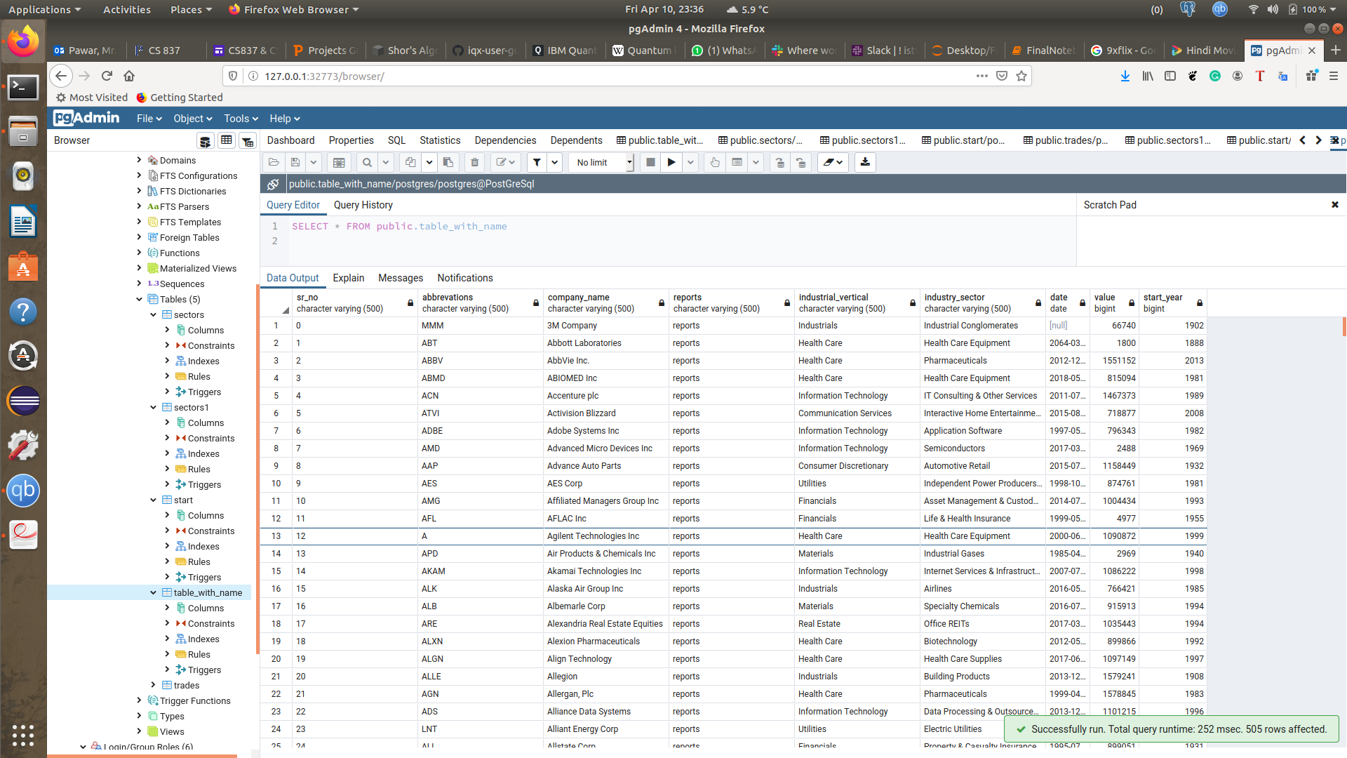
Complete dataset files were loaded in the Postgres using pgAdmin

Slide 6
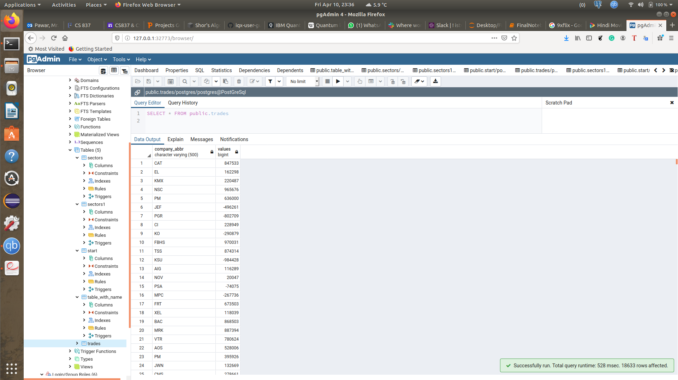

Slide 7
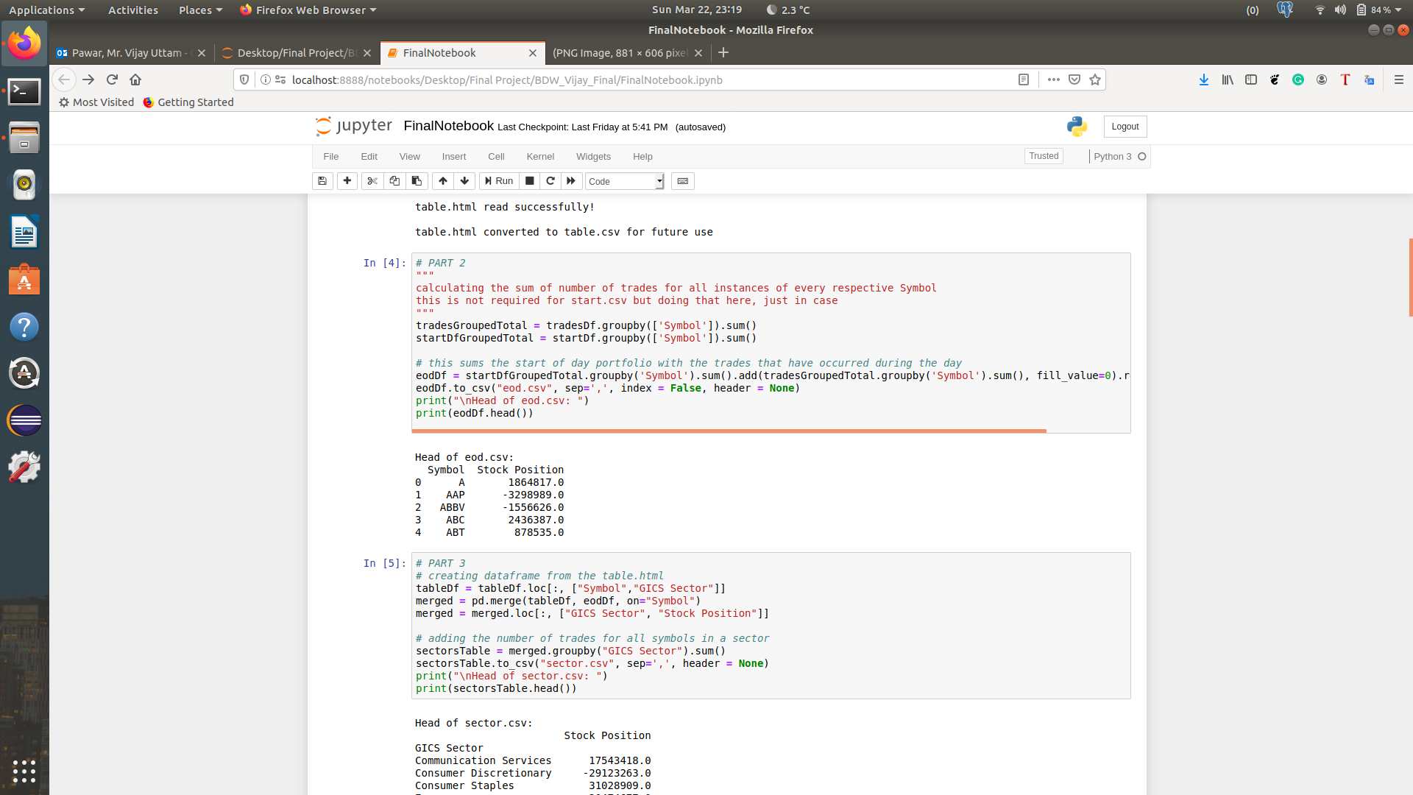

Slide 8
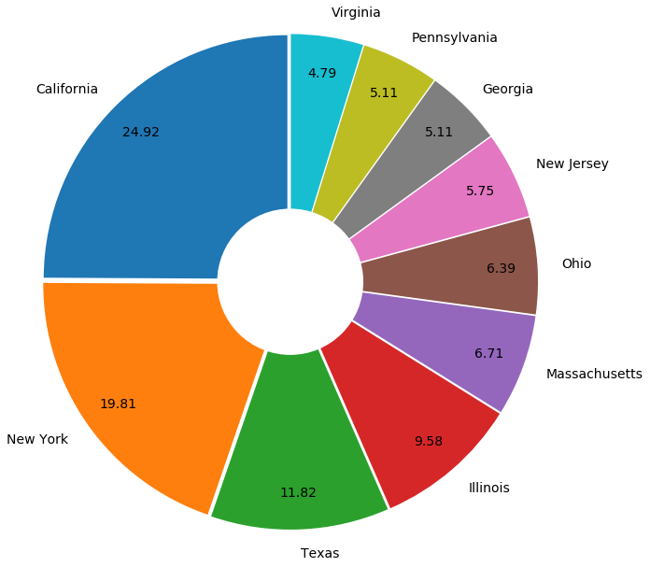
DISTRIBUTION OF TOP 10 STATES

Slide 9
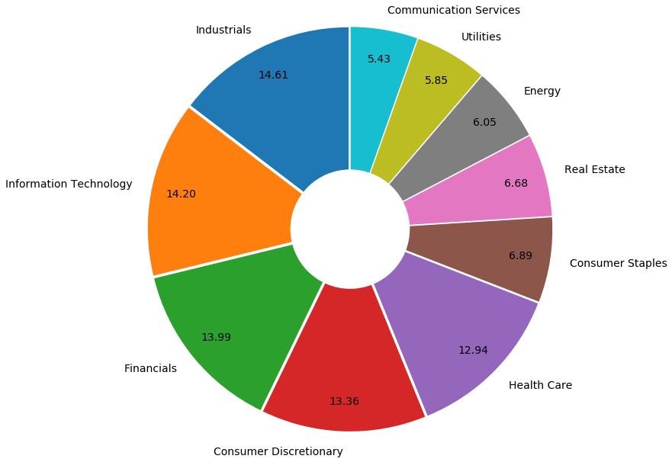
DISTRIBUTION OF TOP 10 SECTORS

Slide 10
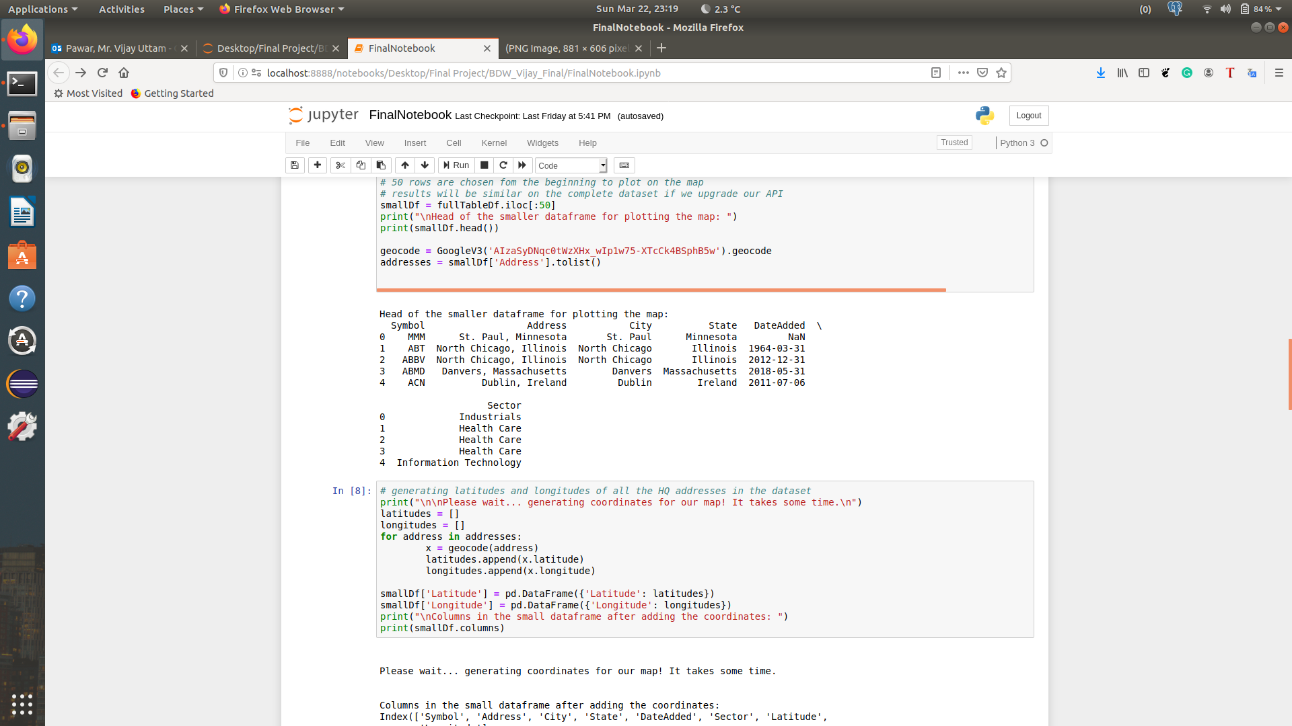

Slide 11
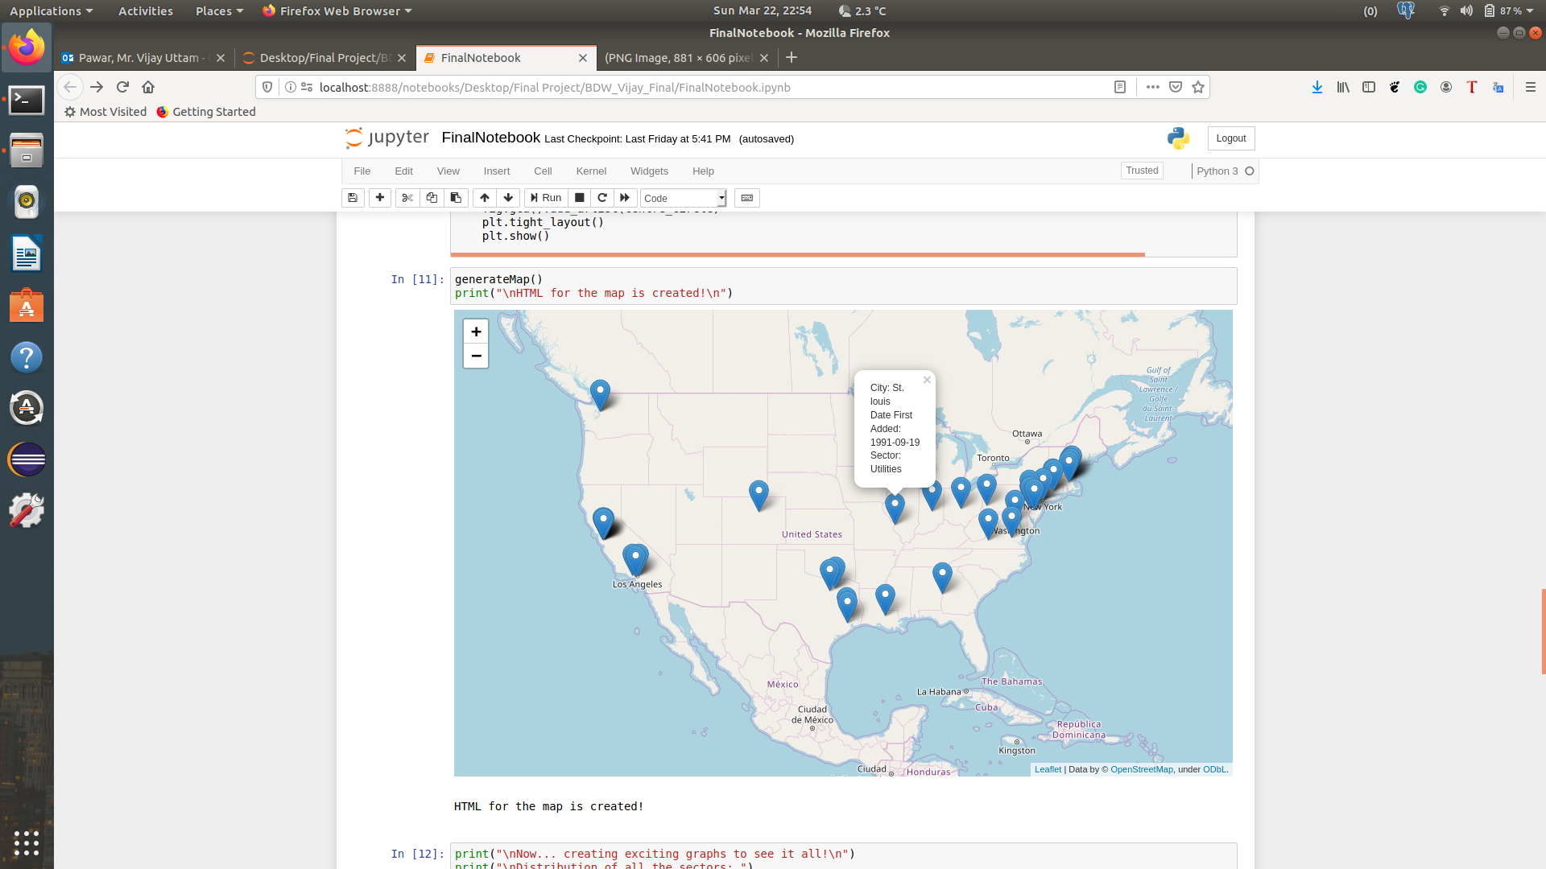

Slide 12
Thank you! 😀

